Slide 1
WELCOME PROSPECTIVE STUDENTS AND FAMILIES!
Notes:
Stacy will open and thank all present.

Slide 2
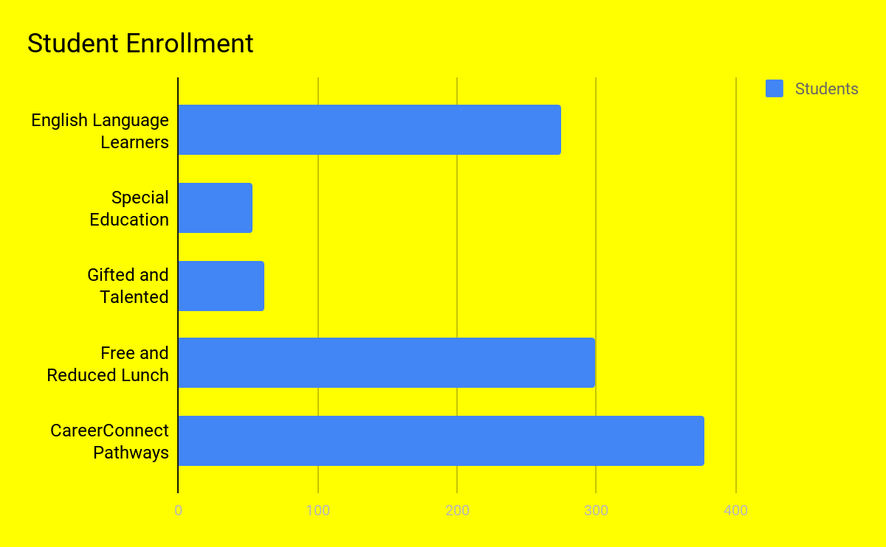
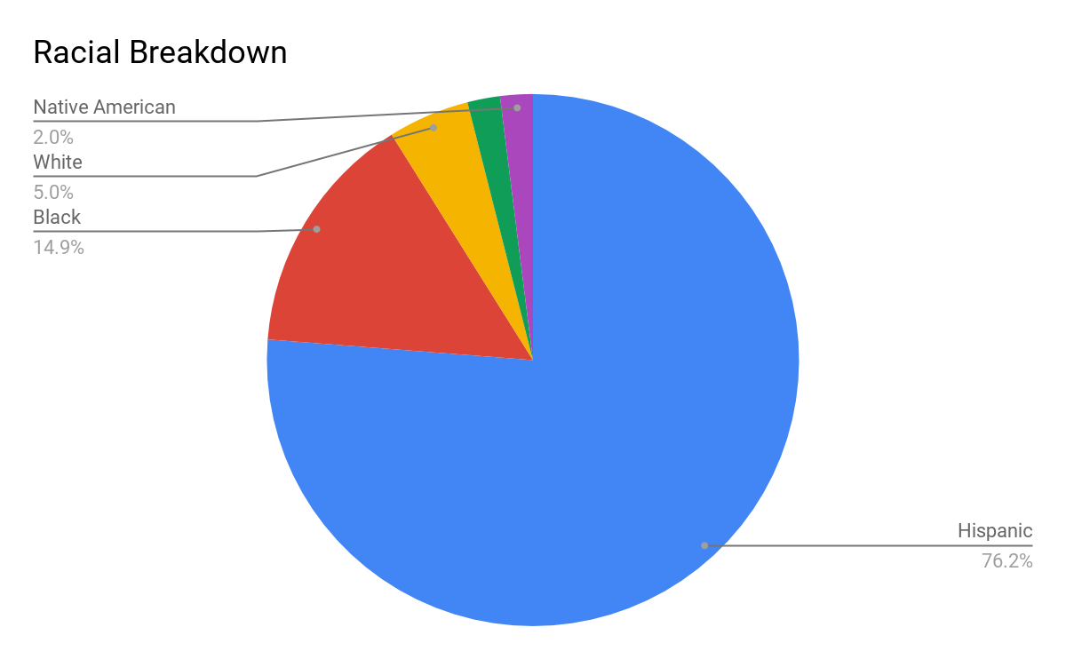
Who Are We?
Notes:
Stacy

Slide 3
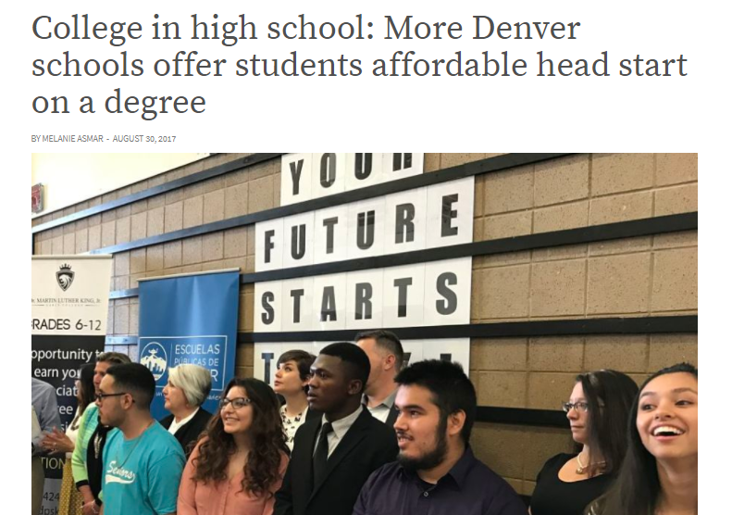
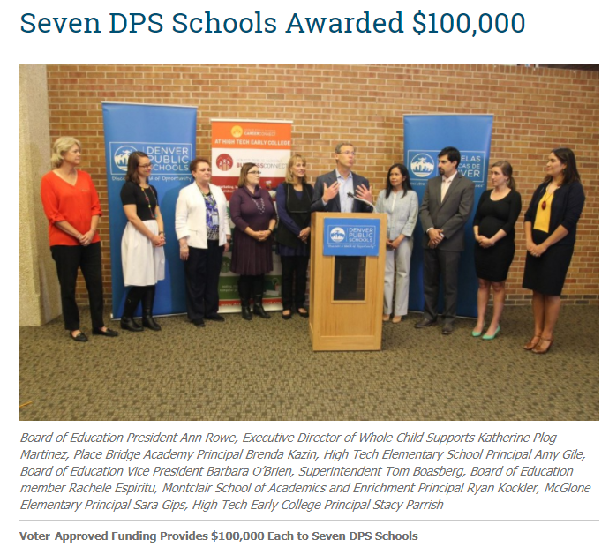
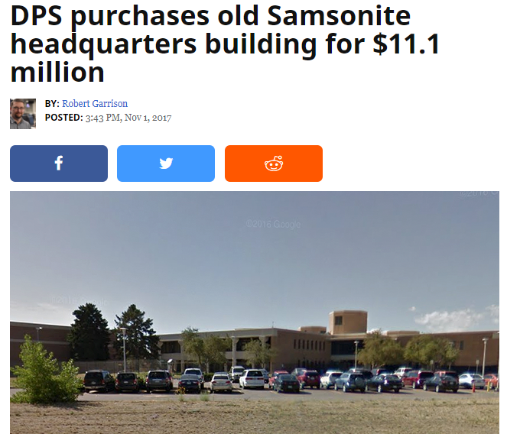
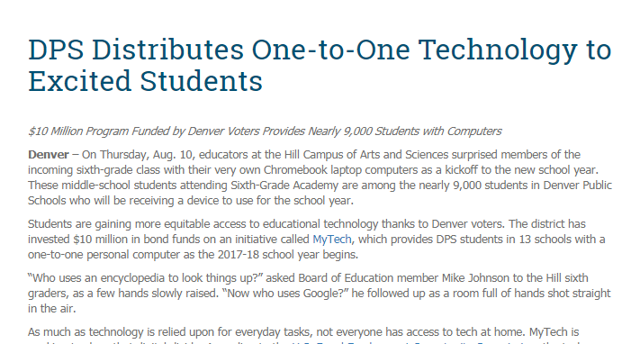
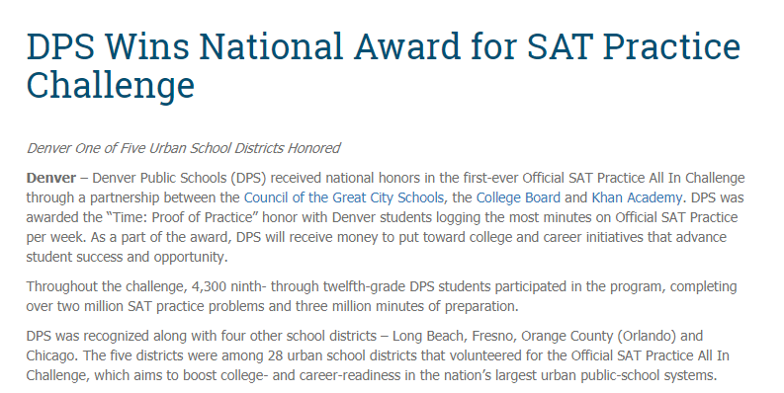
PRESS RELEASES for HTEC
Notes:
Stacy

Slide 4
$$$ CELEBRATIONS FOR HTEC! $$$
-Whole Child Grant $100,000 over two years
-Tech 1:1 Grant $129,000
-KinderMorgan Library Grant $5,000
-Lockheed Martin Engineering $37,000
-DPS Re-engagement Grant $30,000
-Diagnostic Review Grant $30,000
-Boeing Engineering Grant $8,000
-Assorted District Grants $8000
Total $347,000
Notes:
Stacy

Slide 5
Here is what we did in one year...
MATHEMATICS--Increased our remediation-free rate from 47% in 2015-2016 to 64% last year.
ENGLISH LITERACY--Increased our remediation-free rate from 48% in 2015-2016 to 80%.
COLLEGE CREDITS--Increased our college credits earned from 454 in 2015-2016 to 1,163 last year with a 90% pass rate!
HIGH GROWTH in MATH
HIGH GROWTH on the SPF
DISTINGUISHED on the SPF for supporting students of color
Notes:
Stacy

Slide 6
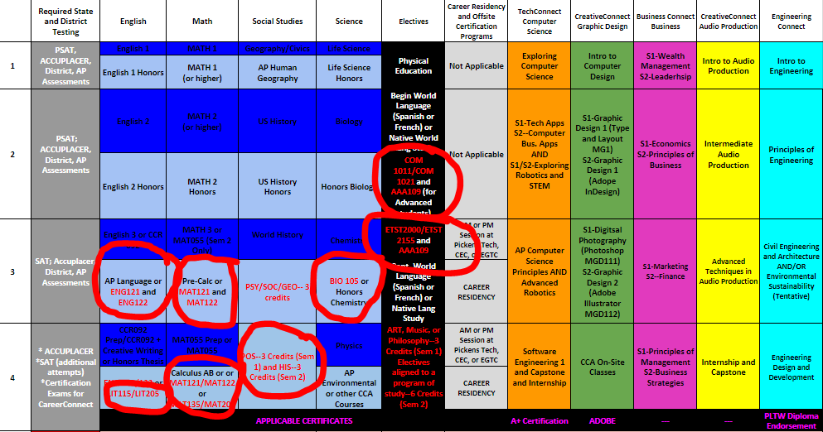
Get Your Associate Degree at HTEC
Notes:
Stacy

Slide 7
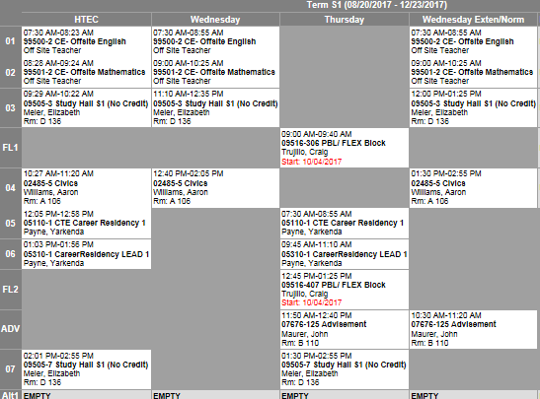
Sample Career Residency Schedule
Notes:
Liz

Slide 8
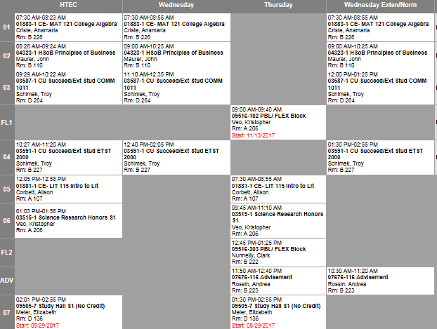
Sample Associate's Degree Schedule
Notes:
Liz

Slide 9
Notes:
Liz

Slide 10
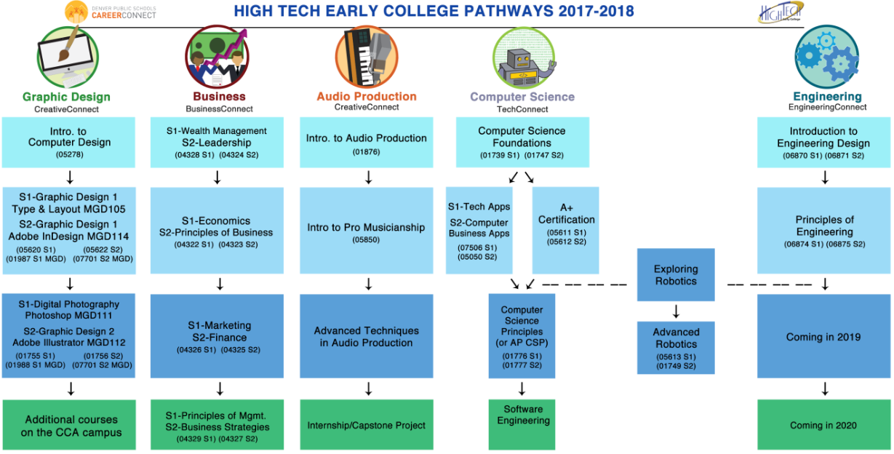
Take a peek at Audio Production written up in 303Magazine!
Notes:
Liz

Slide 11
CEC ELECTIVE PARTNERSHIP
Architectural Tech, Athletic Training/Sports Medicine, Audio Engineering, Automotive Tech, Biomedical Sciences, Business Management, Certified Nursing Assistant, Construction Tech, Crime and Forensics, Criminal Justice/Law, Culinary Arts, Digital Film Production, Fashion Design, Fire Science, Fitness Trainer, Medical Careers, Multimedia Graphic Design, Teaching Careers, Video Game Programming and Welding
Notes:
Liz

Slide 12
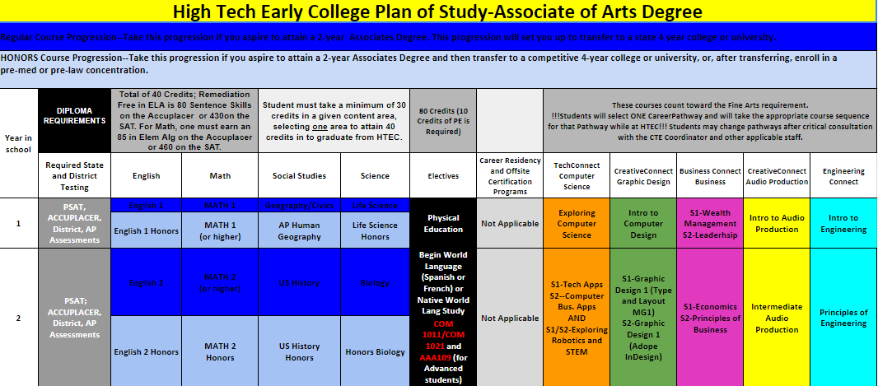
What courses will I take Freshman year?
Notes:
Liz

Slide 13
Check out the flyer!
Community (1:17 ratio)
Our scholars (100%!) are involved in extracurricular activities!
Restorative Justice
Whole Child focused and FUNDED!
Freshman Academy
Summer Bridge Program **NEW
OPEN DOOR POLICY
Notes:
Stacy

Slide 14
CareerResidency
The CareerResidency is a groundbreaking new program in DPS that revolutionizes high school education and provides students with direct routes to careers and higher education.
•The CareerResidency lasts three years
•You can enter the CareerResidency your junior or senior year
A CAREERRESIDENCY STUDENT EARNS
Notes:
Lliz

Slide 15
Notes:
stacy

Slide 16
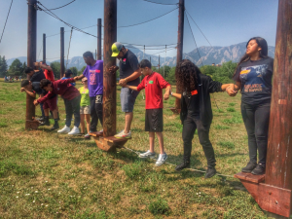
Important Information
TRANSPORTATION
FNE Enrollment Boundary students ride the Success Express. Students living outside the boundary can purchase a discounted RTD pass each month for $25.
ATHLETICS
All athletes participate in the FNE Warrior Athletic Program.
Notes:
Stacy

Slide 17
School of Choice Process--
http://schoolchoice.dpsk12.org/
1st Round of School Choice OPENS February 1 and closes February 28th at 4:00PM.
Last year we filled quickly and were the 1st, 2nd, 3rd, 4th, and 5th choice of all FNE non-charter schools.
Notes:
Stacy

Slide 18
Shadow Days
Fridays in January & February from 8 a.m. till noon. Sign up with Ms. Liz before you leave today. Dates listed below:
January 12
January 19
January 26
February 2
February 9
February 16
February 23
Notes:
Liz

